Slide 1
17-612 Fall 2023
Business & Marketing Strategy
Class 4
Jim Berardone
Associate Professor of the Practice of Product Management

Slide 2
Slack Channel #bms23 in the Masters of Software Engineering workspace
If you haven’t been invited to the channel, let me know.

Slide 3
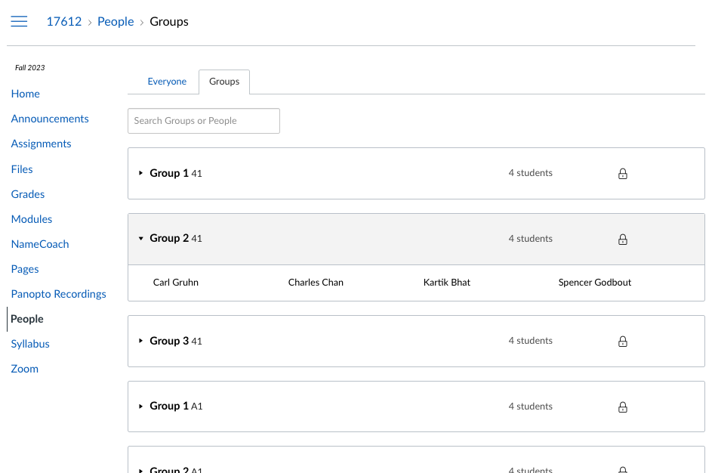
Peer Learning Activity No. 1
Peer Groups have been formed on Canvas.
You should have received an Invitation.
Your group is identified by your Section and a number.
All groups have students in the same Section (A1, B1, 41)…except 1 student.
Most groups have 4 students. A few have 3 students.

Slide 4
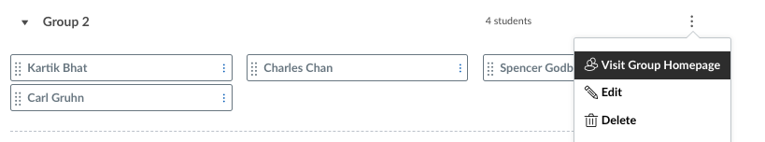
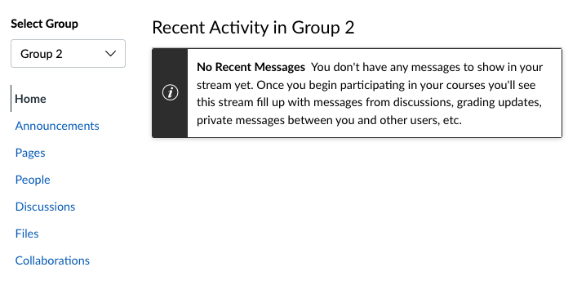
Click on Collaborations

Slide 5
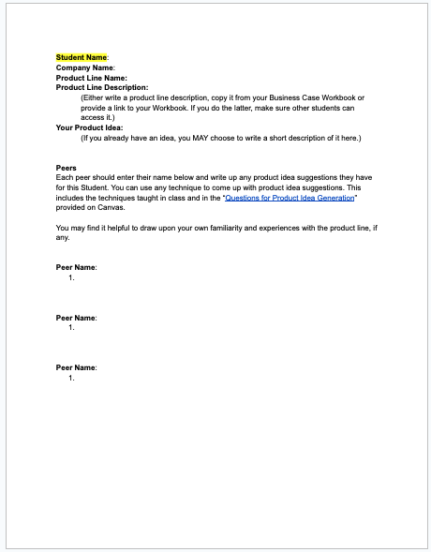
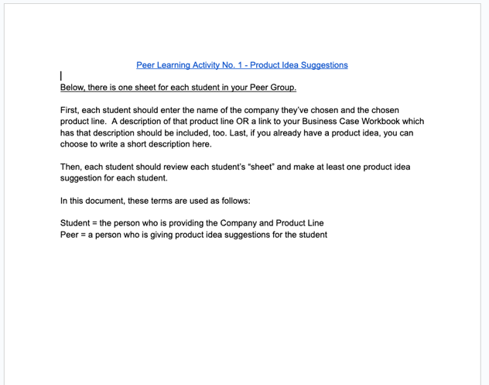
Peer Learning Activity No. 1 template (google doc)
Use this for YOUR peer group.
In the doc, there is 1 sheet per student in the Peer Group.
TODAY: Each student should enter their Name, Co. Name, Product Line, Description (and, optionally, their idea) on 1 sheet.

Slide 6
Today’s Class
Product Idea Generation
Workshop: Idea Generation
Strategy Alignment
Product Idea Description

Slide 7
Product Idea Generation

Slide 8
We create and commercialize products to solve a customer problem.
Customer
Problem analysis
Problem statement
Product Idea
Concept Design Views
Customer Problem
Solution

Slide 9
Be Bold with your ideas if high growth is the goal!
Incremental innovation
– focuses on improving existing products with new features, designs, delivery
- lower risks often leads to lower rewards
Example:
Gmail evolved from delivering email well to include many improvements
Disruptive innovation
- focuses on new products that creates a dramatic change in how something gets done
- higher risks requires higher rewards
Example:
digital imaging disruptive film-based imaging (Kodak)

Slide 10
Create a strong difference that customers will value!
Product Differentiation
Characteristics of your product that make it more attractive to customers than alternatives.
→ Strong differentiation is 1 of the 2 factors behind the most successful products.
Just because your product is different doesn’t mean it’s differentiated!
Customers must find value in that difference.

Slide 11
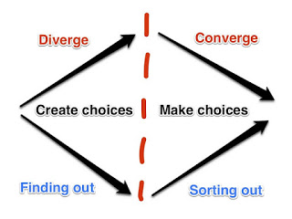
Generate MANY ideas before evaluating and selecting an idea.
Selected
Product Idea
Separate CONCEIVING Ideas from SELECTING Ideas.
Gives you a chance to combine parts to form a better idea.
Image Source: Portions - Brown, T. “Change by Design” and libedge.blogspot.com

Slide 12
Idea Generation: There are many techniques.
Brainstorming
Brainstorm with an outsider
Structured brainstorming
SCAMPER
Crazy Eights
6-3-5 method
Round Robin
Welcome unusual ideas
Build upon ideas
Flip bad ideas
Wishing
TRIZ method
Six hats thinking
Innovation contests
Storyboarding
Paper prototyping
Lo-fidelity prototyping
Participatory design
Experience diagramming
Patent mapping
Future scenarios
More…
Notes:
I’ll go through the first 11 quickly. The others you can find easily with an online search.

Slide 13
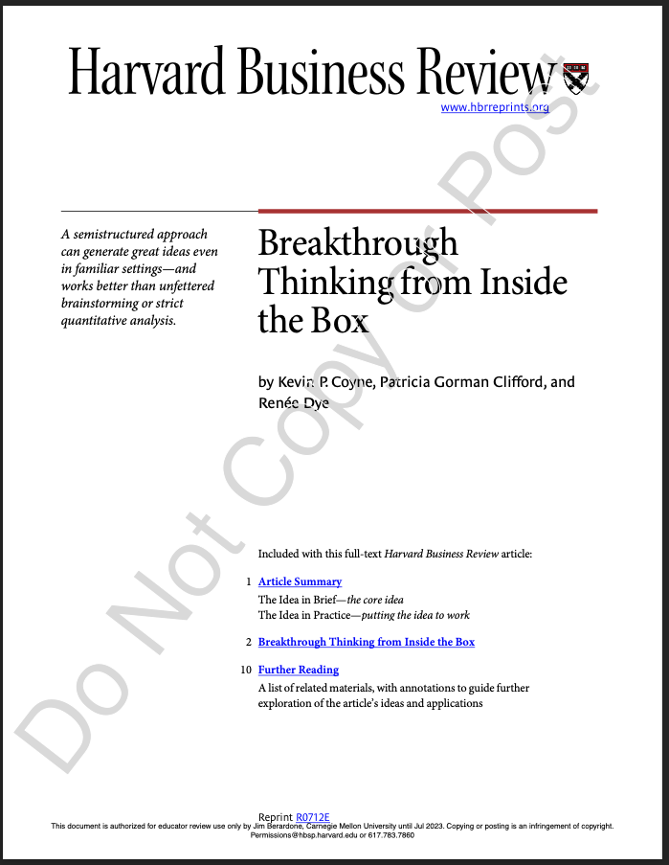
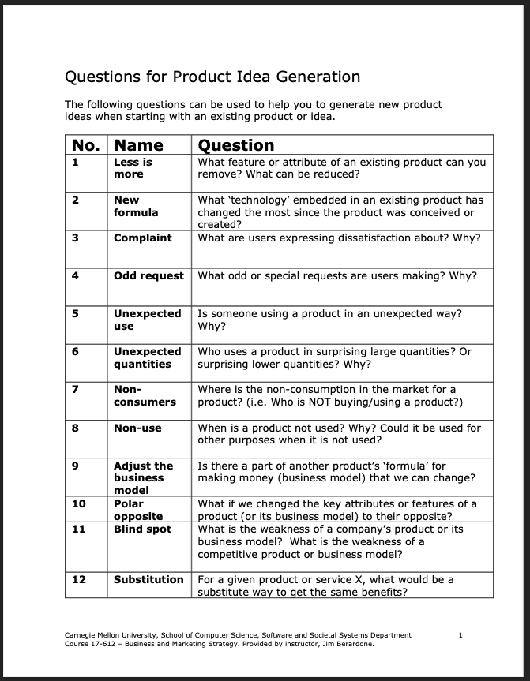
Structured brainstorming Pose specific questions that focus people’s thinking to spark fresh ideas
On Canvas
Questions for Generating Product Ideas.pdf
In HBP Coursepack

Slide 14
Take the product OR product line and ask a question:
No. | Name | Question
1 | Less is More | What feature or attribute of the product can be removed or reduced?
2 | New Formula | What “technology” in the existing product has changed the most since the product was created?
3 | Complaint | What are users expressing dissatisfaction about? Why?
7 | Non-consumers | Where is the non-consumption in the market? (i.e., who is NOT buying / using the product? Why?
11 | Blind spot | What is the weakness of the product or its business model?
12 | Substitution | What would be a substitute way to get the same benefits?
30 | Technology Roadmap | Which technology(s) could have an impact on the product or product line within X years?
Questions are taken from the document:
Questions for Generating Product Ideas.pdf

Slide 15
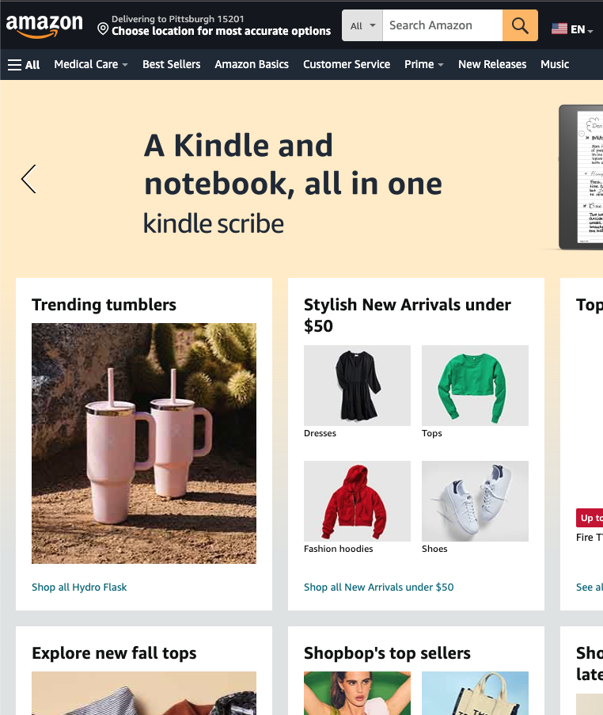
Discussion: Given the product “Amazon.com”
1 | Less is More | What feature or attribute of the product can be removed or reduced?
2 | New Formula | What “technology” in the existing product has changed the most since the product was created?
Notes:
Ask Why?

Slide 16
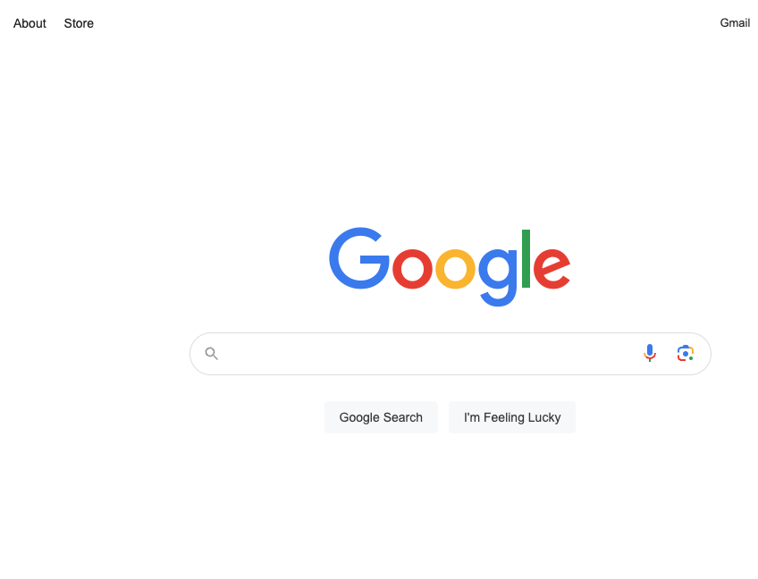
Discussion: Given the product “Google Search”
3 | Complaint | What are users expressing dissatisfaction about? Why?
9 | Adjust the business model | Is there a part of the product’s “formula” for making money that we can change?

Slide 17
Workshop: Idea Generation

Slide 18
How this will work.
Get in groups of 3 students – quickly!!!
There will be 3 segments of the workshop.
1st segment: 5-7 minutes
2 min. Student A explains Company, Product Line (and idea, if you have one already)
3-5 min. Student B and C offer ideas to Student A.
Student A captures the ideas.
Use the Questions to generate ideas
Move on to next question as needed.
2nd and 3rd segment: 5-7 minutes each
Repeat above, rotate Student

Slide 19
Goals and expectations
Generate as many ideas as possible, good or bad, from others.
Ideas can be fragments of ideas
Do not evaluate or critique anything.
You can ask questions to better understand the products or suggestions.

Slide 20
Let’s get into your groups -- quickly!

Slide 21
Discussion
Which Question, if any, was most effective in your group?
What would you do differently the next time or if you had more time?

Slide 22
Strategy Alignment

Slide 23
Strategy Alignment
Companies want to be sure its resources are used in a way that fits its strategy, purpose and values.
Some ideas can be great – but are not a good fit for the company.
How does your idea support the company strategy? the product line strategy?
How will it help us to achieve the Objective?
Does it fit the Scope?
Does it strengthen or use our Advantage?
Does if fit How we will achieve our Objective?

Slide 24
Strategy Alignment is not Binary – All or Nothing
It is usually along a spectrum.
Not aligned at all.
Fully aligned
The more aligned it is, the more persuasive your idea will be.
You may need to adjust your idea to increase the alignment.
As strategies change, the idea/product may need to change.

Slide 25
Product Idea Descriptions

Slide 26
Use these 9 elements to describe your product idea at this early stage.
Product Name
Type of Product
Main Function
Product Attributes
Competitive Differentiator
6. Key Technology
7. Product Complements
8. Visual
9. How it works
Next week, we’ll discuss the markets and users.

Slide 27
Explanations
 | Question | Your answer should be…
Product Name | What is the product’s name? | A temporary or trademarkable identifier.
Type of Product | What kind of product is it? | A category the product would belong to.
Main Function(s) | What will be product do? | The main activity(s) it will do.
Product Attributes | What are the its characteristics? | The key features and traits
Competitive Differentiator | What is the key product attribute that provides the most unique benefit? | The unique feature and benefit
Key Technology | What “technology” will be “inside”? | The key internal parts of the product.
Product Complements | What other products does the customer need for this product to work? | The platform, systems, and/or services.
Visual | What will it look like? | A ‘sketch’ of the product or a key part of it.
How it Works | How will it be used by the user? | Concisely describe how the product will work from the user’s perspective.

Slide 28
On Canvas: More explanation and examples

Slide 29
Main Function and Product Attributes
Attributes are characteristics of a product.
Main Function is an attribute that are the main capability(s) of the product
Features – a characteristic of the product that is more specific than the main function(s)
Form (size, style, material, weight)
Or, Format (Web, iOS app, Android app, CSV file, etc.)
Quality (robustness, availability, safety, reliability, etc.)
You get to name the feature if it’s not commonly known already
e.g., Cruise control. Keyless remote. 1:1 Video calling.

Slide 30
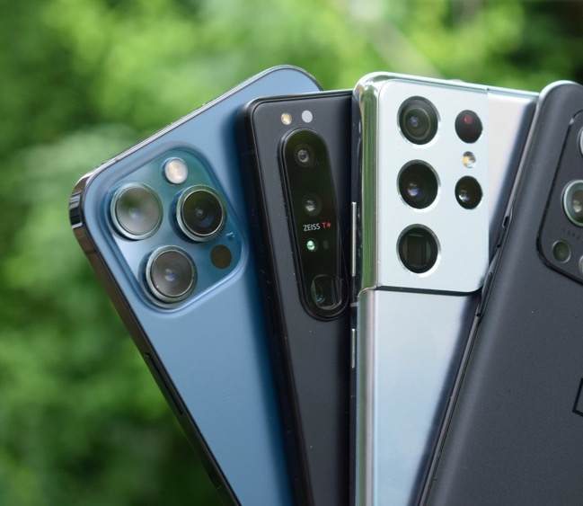
Type of product
A classification of products and services that are similar in purpose, functionality, form or format.
Makes it easier for customers to find and refer to products.
Examples:
- Smartphone
- Digital marketplace
- Notetaking app
Image Source: https://www.androidauthority.com/best-camera-phone-test-mid-2021-1648623/

Slide 31
Key Technology
The most important technology used “inside” your product or service.
Technology can be: software, systems, devices, components, algorithms, methods, materials, data.
Prompt:
What are the key software and non-software items “inside” your product?
Examples:
iPhone: LCD display, Gorilla Glass, iOS. IC chips. Accelerometer sensor.
Google Maps: Machine Learning algorithm for route optimization
Waze: Traffic monitoring and forecasting system
What is the Key Technologies of:
Google Search
Airbnb

Slide 32
How it works
Concisely explain how the product will work to solve the problem, from the user’s (actor’s) perspective.
This helps to convey the concept, in writing. Later, visuals will be created, too.
You likely need to explain this for one use case.
Focus on the key path of use, from start to finish. Don’t cover set up or updating.
Walk the reader through the main steps of the journey, if appropriate.
Be sure to cover what is unique about your solution.
Example: Uber Ride
The rider enters their destination into a “Where to?” box; reviews each ride option for vehicle size, price, and estimated drop-off time and chooses the desired option. The rider is automatically matched with a driver. The rider confirms the pickup. The driver picks up the rider and takes the rider to the destination. The driver and rider post reviews and ratings.

Slide 33
The End

